Slide 1
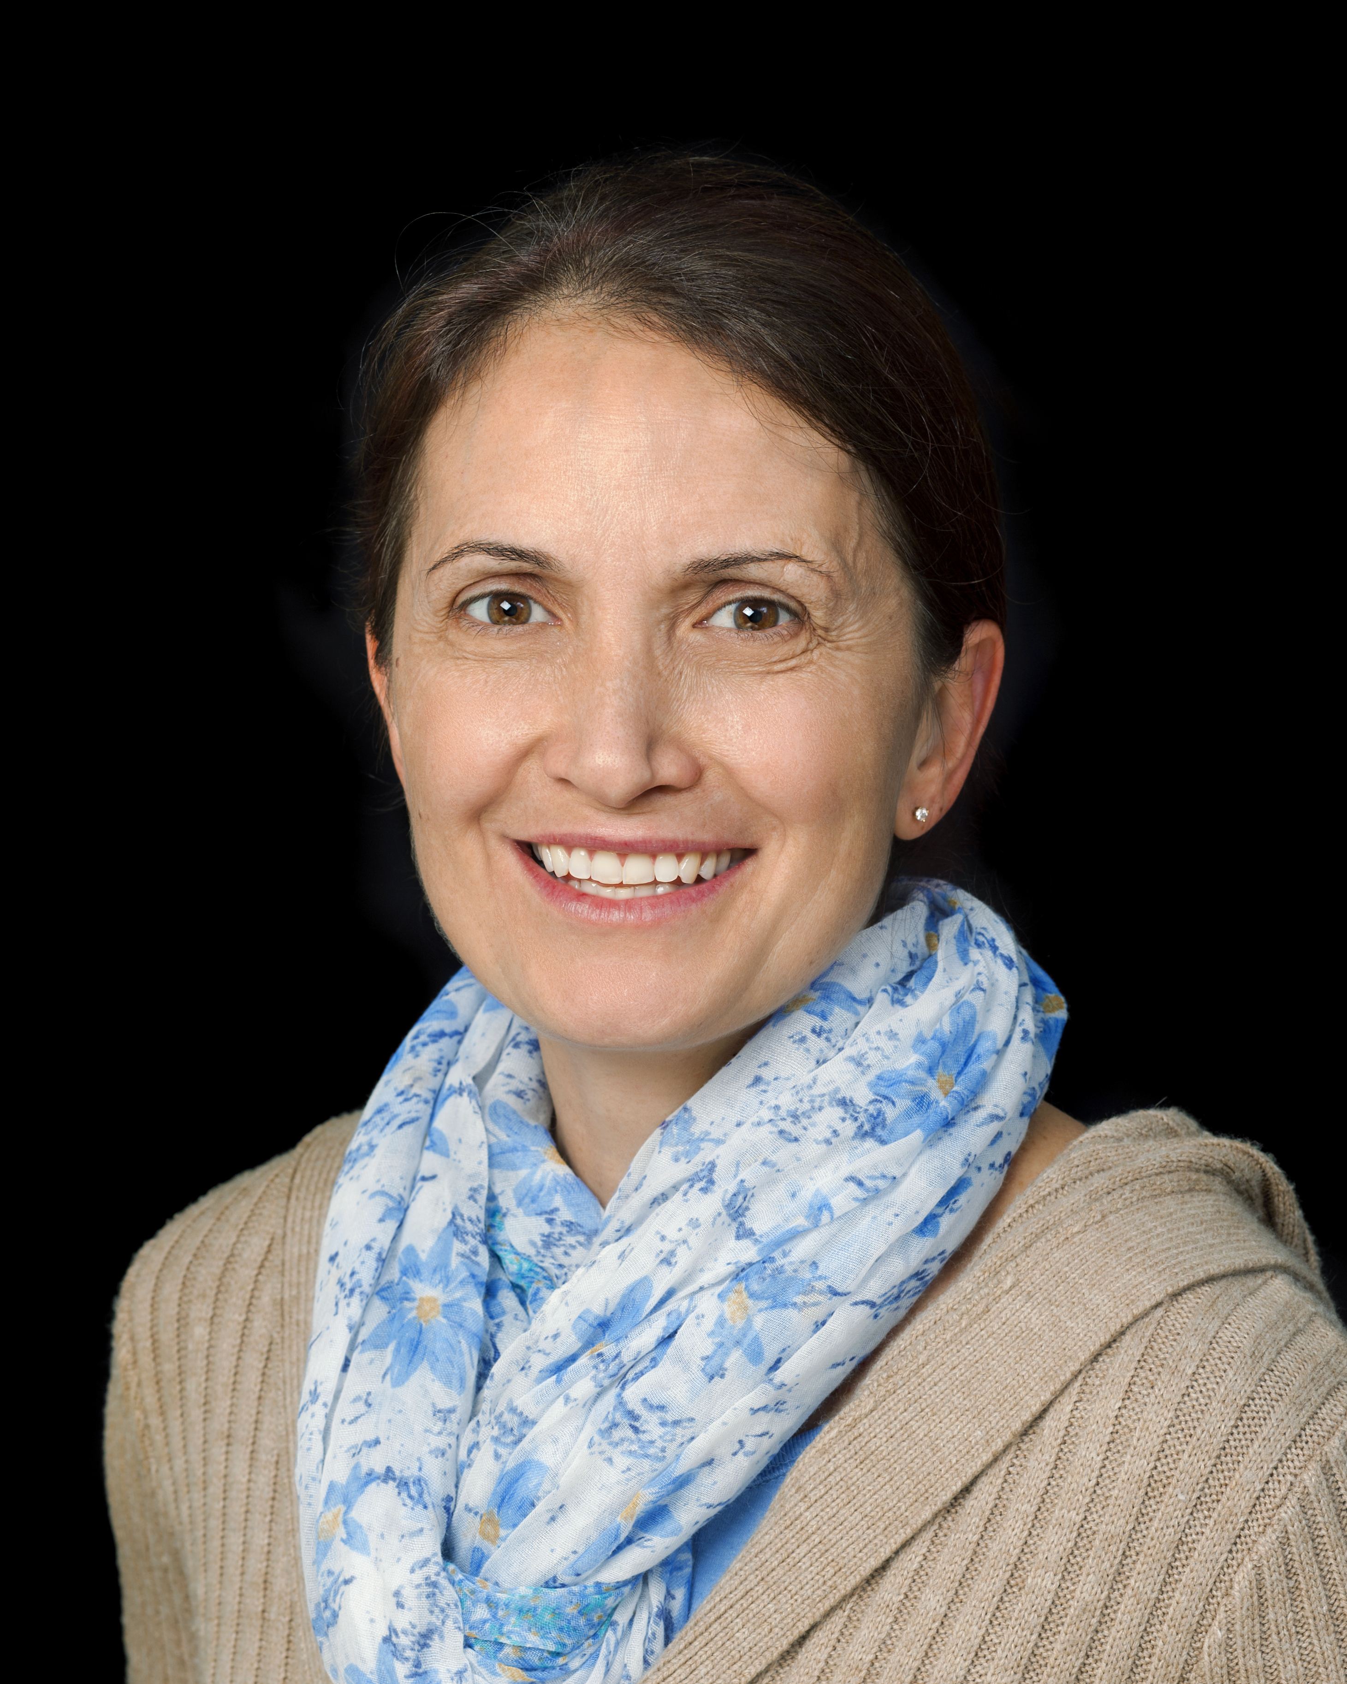
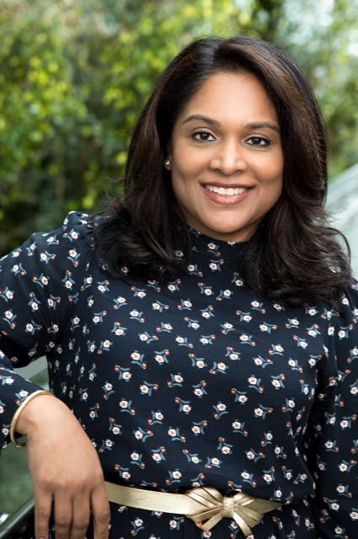
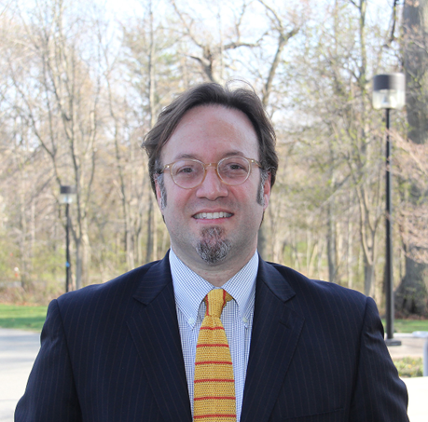
SUNY Old Westbury School of Education & TLRC
Meeting the Needs of Students with Exceptionalities at OW
A workshop with faculty from the School of Education's Exceptional Education & Learning Department
Lina Gilic
Calling All OW Faculty!
During our time together, faculty responsibilities regarding undergraduate and graduate students with exceptionalities will be discussed. We will examine what constitutes an appropriate college-level education and the laws relevant to the education of students with exceptionalities. We will also share specific classroom strategies to effectively meet the needs of students with exceptionalities at our University.
Looking forward to seeing all faculty!
Shalinie Sarju
Julio C. González
When: Monday, February 12, 2024
Time: Common Hour 1:30 p.m. – 2:30 p.m.
Format: In-Person on Campus
Location: Student Union Panther’s Pad
Refreshments will be provided

